Slide 1
Medical INSURANCE cost prediction
Presented to: Mr. Vijay Kumar
Presented by: Ms.Reshma Retnamma

Slide 2
Business understanding
What Is Health Insurance?
According to the Health Insurance Association of America, health insurance is defined as "coverage that provides for the payments of benefits as a result of sickness or injury. It includes insurance for losses from accident, medical expense, disability, or accidental death and dismemberment“.
Health insurance is a type of insurance coverage that typically pays for medical, surgical, prescription drug and sometimes dental expenses incurred by the insured.

Slide 3
About the data
The insurance.csv dataset contains 1338 observations (rows) and 7 features (columns).
The purposes of this exercise to look into different features to observe their relationships, and to build regression models based on given features .Existing medical expense to be used for predicting future medical expenses of individuals that help medical insurance to make decision on charging the premium.
Note: This data set was found from Kaggle

Slide 4
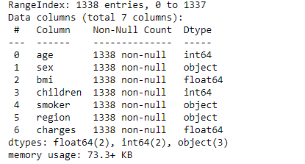
Variable description
1. | age | : | age of primary beneficiary
2. | sex | : | insurance contractor gender, female, male
3. | BMI | : | Body mass index, providing an understanding of body, weights that are relatively high or low relative to height.
4. | children | : | Number of children covered by health insurance / Number of dependents
5. | smoker | : | Smoking
6 | region | : | the beneficiary's residential area in the US, northeast, southeast, southwest, northwest.
7. | charges | : | Individual medical costs billed by health insurance
Target variable

Slide 5
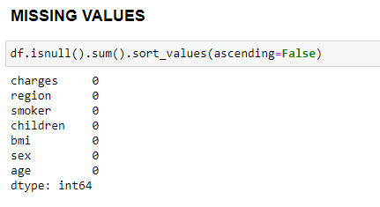
Exploratory Data Analysis
Missing values
There are no missing values in the given dataset

Slide 6
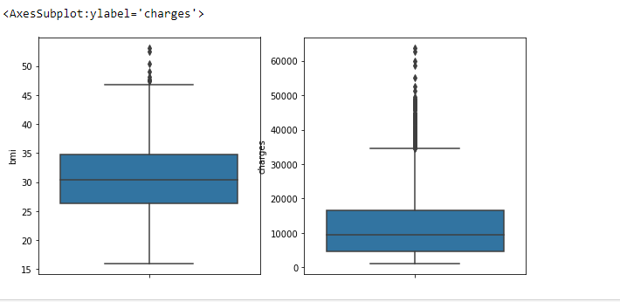
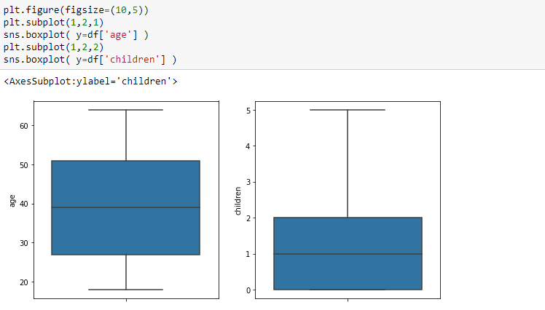
OUTLIER ANALYSIS
It can be seen that there are no outliers in the given columns
It can be seen that there are outliers in the charges and bmi columns

Slide 7
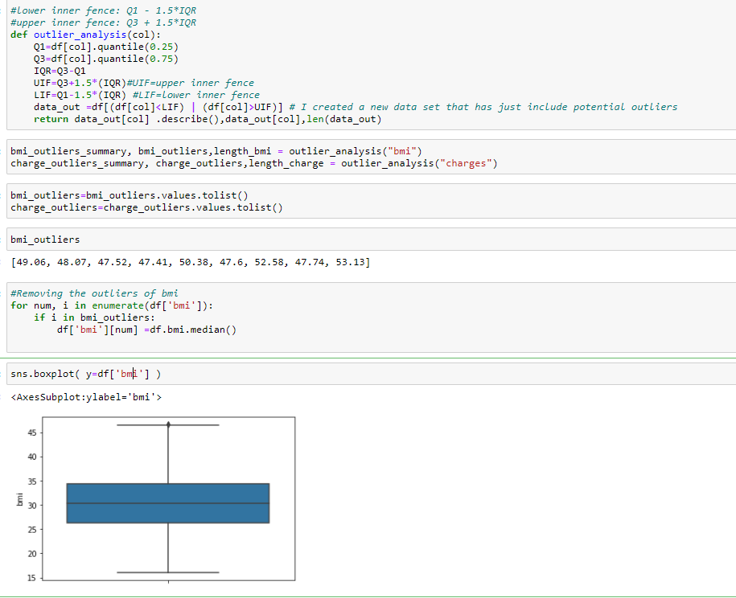
Handling outliers
Outliers were replaced using median

Slide 8
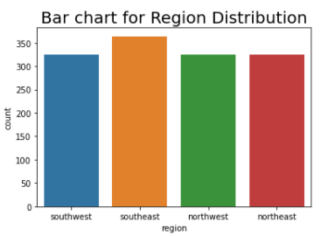
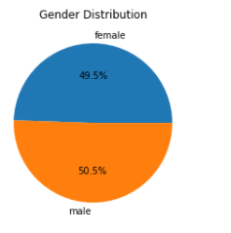
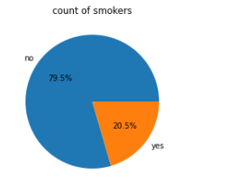
Univariate analysis
-Region
-sex
-smoker
It can be seen that in the given dataset we have 49.5% of females and 50.5% of males
It can be seen that in the given data set we have 79.5% of non smokers and 20.5% of smokers.
Most number of people belong to the southeast region and all other regions has almost same number of people

Slide 9
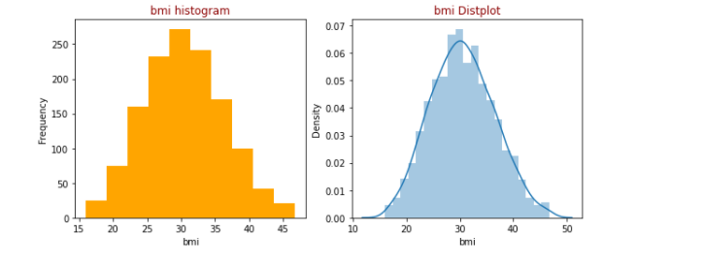
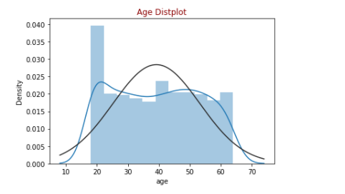
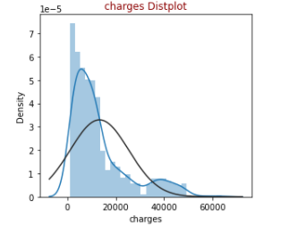
Univariate analysis-cont..
The distribution of age characteristics according to the normal distribution. In fact, there does not seem to be a big difference with the normal distribution, but it can still be corrected.
BMI is almost normally distributed .
Charges is heavily skewed towards right and most of the distribution is between 0-20000.

Slide 10
Bivariate analysis
BUSINESS QUESTIONS
Is there any relation between sex and charges?
Is there any relation between smoker(smoking status) and charges?
Is there any relation between region and charges?
Is there any relation between bmi and charges?
Is there any relation between age and charges?

Slide 11
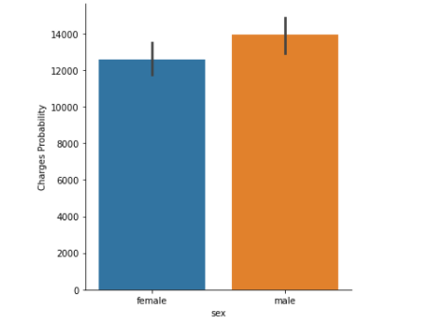
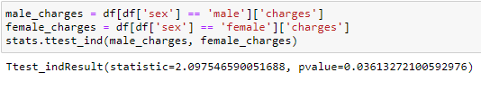
Is there any relation between sex and charges?
From the above chart we can see that charges are higher for males compared to females.
Q1
We are interested in knowing if there is a relationship between charges and sex
hypothesis.
H0:There is no statistically significant relationship between sex and charges
Ha: There is a statistically significant relationship between sex and charges
Here the p value is 0.03 which is less than .05,therefore we reject the null hypothesis at 5% significance level .There is a statistically significant relationship between sex and charges. Which means gender impacts the medical insurance cost.

Slide 12
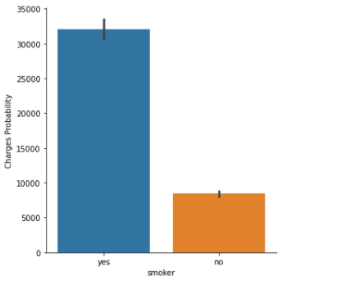
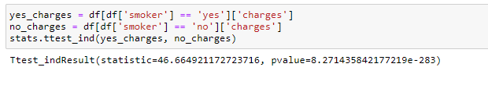
Is there any relation between smoking status and charges?
From the above chart we can see that charges are higher for smokers compared to non-smokers.
Q2
We are interested in knowing if there is a relationship between charges and smoking status
hypothesis.
H0:There is no statistically significant relationship between smoking status and charges
Ha: There is a statistically significant relationship between smoking status and charges
Here the p value is 8.2e-283 which is less than .05,therefore we reject the null hypothesis at 5% significance level .There is a statistically significant relationship between smoking and charges. Which means smoking status impacts the medical insurance cost.

Slide 13
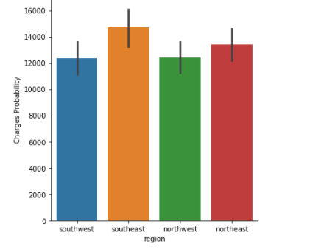
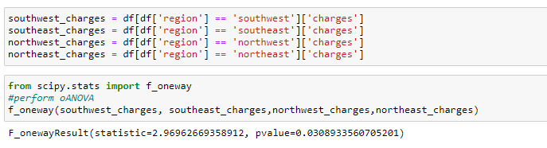
Is there any relation between region and charges?
From the above chart we can see that charges are higher for southeast region
Q3
We are interested in knowing if there is a relationship between charges and smoking status
hypothesis.
H0:There is no statistically significant relationship between region and charges
Ha: There is a statistically significant relationship between region and charges
Here the p value is 0.03 which is less than .05,therefore we reject the null hypothesis at 5% significance level .There is a statistically significant relationship between region and charges. Which means region impacts the medical insurance cost.

Slide 14
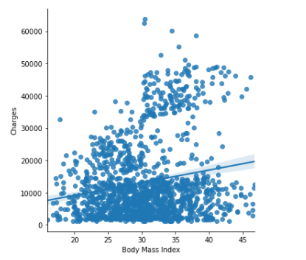
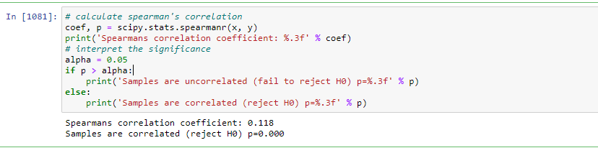
Is there any relation between bmi and charges?
From the above chart we can see that charges and bmi are correlated
Q4
We are interested in knowing if there is a relationship between charges and bmi
hypothesis.
H0:There is no statistically significant relationship between bmi and charges
Ha: There is a statistically significant relationship between bmi and charges
Here the p value is 0 which is less than .05,therefore we reject the null hypothesis at 5% significance level .There is a statisticall significant relationship between bmi and charges. Which means region impacts the medical insurance cost.

Slide 15
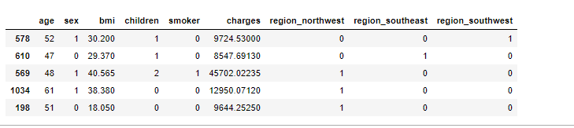
Data set was encoded and shuffled

Slide 16
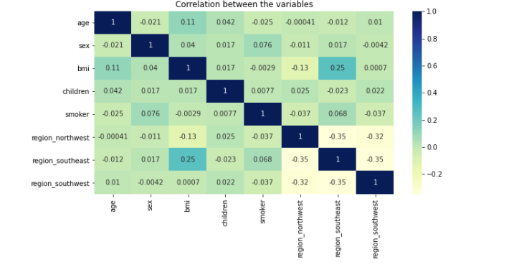
correlation
There is no strong correlation between variables

Slide 17
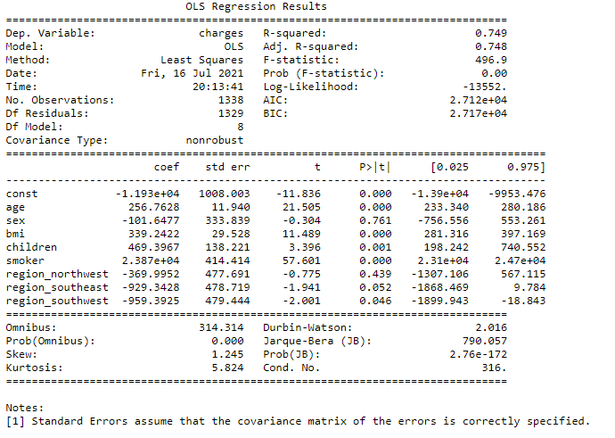
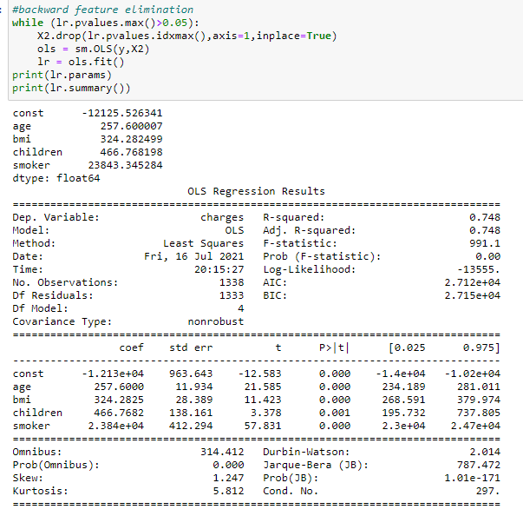

Slide 18
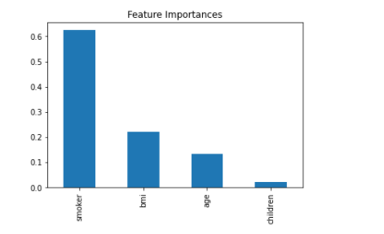
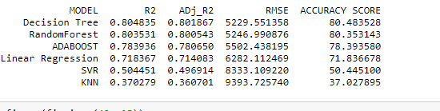
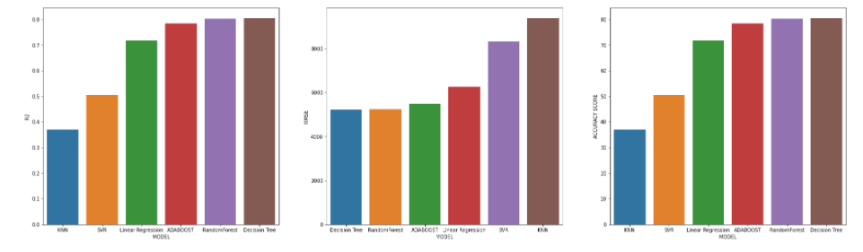
Data was split into test and train and 6 different Regression models were built and compared to find the best suited one.
CONCLUSION
From the above comparison we can conclude that Random Forest model and decision tree models best fits the best fits the given data to predict the Insurance charges as it has low RMSE and high R2 and accuracy score compared to other models. The model with weakest performance is KNN

Slide 19
Conclusion and recommendation
conclusion
Recommendations
Most important factors that affect the medical insurance cost are
1.smoking status-Smokers incur a higher medical cost compared to non –smokers
2.BMI-Medical cost goes up with increasein bmi
3.Age-Medical insurance cost increases with age
4.No of children-This factordoesnot affect the cost in a bigger extent.
Certain area to be concentrated are
1.smoking should be made on of the main criteria to decide the insurance premium. Existing customers can be given awareness to quit smoking.
2.BMI-Higher the bmi ,higher should be the premium and fitness awareness can be given to existing customers
3.Age-Company should concentrate more on younger target groups.

Slide 20
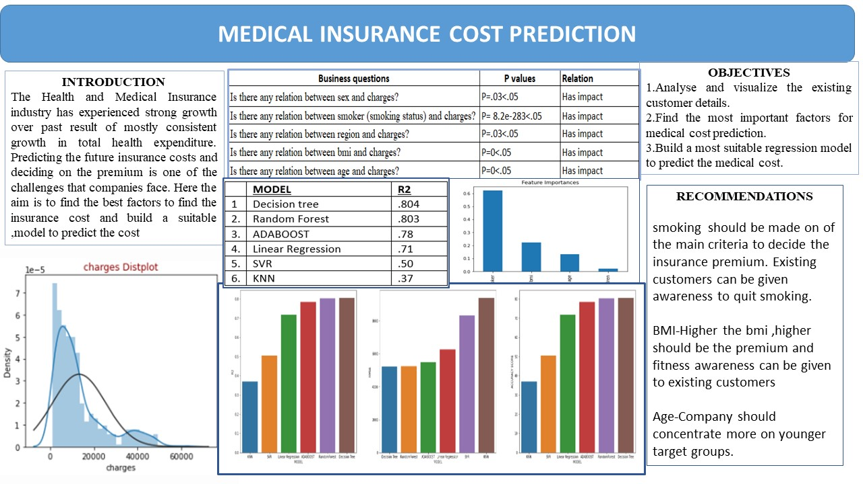

Slide 21
Thank you!!

